Slide 1

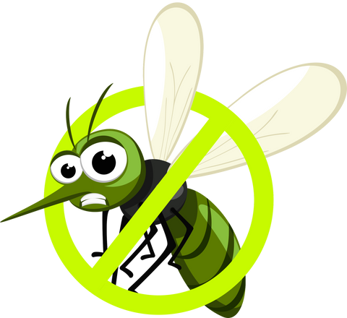
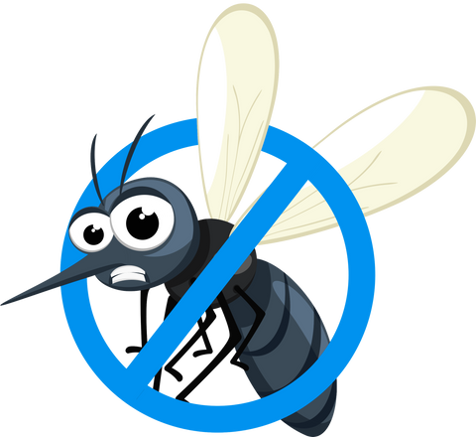

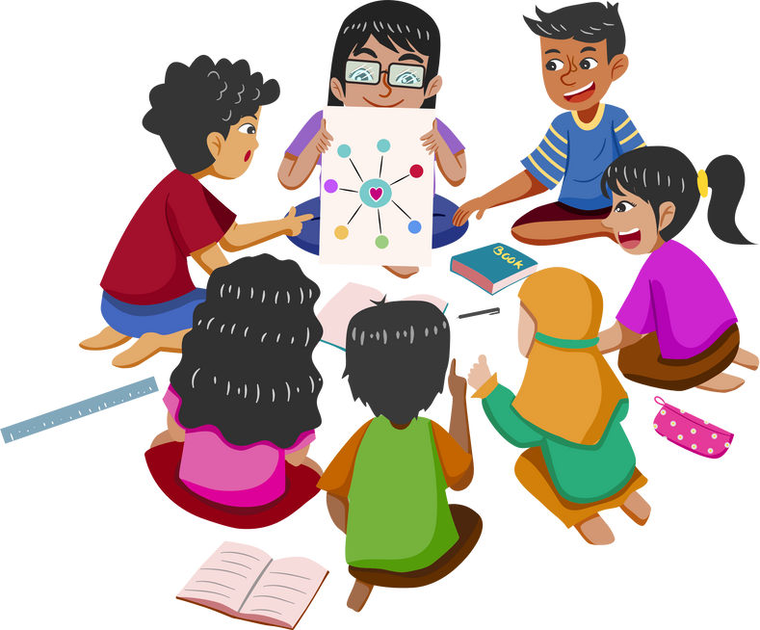
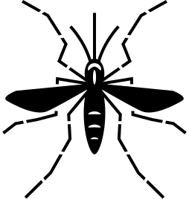




MOSQUITO NO MORE
Activity
book!

Slide 2






🎨 Activity:
Draw and Sequence the Mosquito’s Life Cycle
Materials:
Blank paper, pencils, crayons or markers, scissors, glue (optional).
Instructions:
  Draw each of the four stages of the mosquito life cycle: Egg, Larva, Pupa, Adult.
  Cut out the drawings (if possible) and arrange them in the correct order.
  Glue them onto a separate sheet or simply number them correctly.
  Share your work with the class and explain why each stage is important.

Slide 3
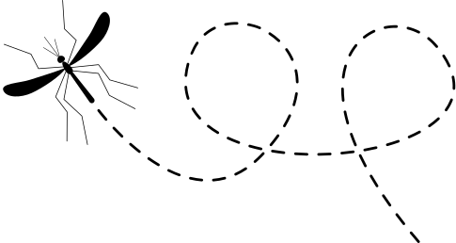

REFLECTION
Where have you seen stagnant water in your community?
Discuss why this is a problem.
🗣️

Slide 4


🎭 Activity:
Role-Playing Game – Mosquito, Person, and Virus
Materials:
Paper, markers, tape, printed role cards (optional).
Instructions:
  Assign three students to play different roles:
  Mosquito: Walks around pretending to "bite" people.
  Person: Reacts when bitten and may get sick.
  Virus: Explains what happens when they enter a person’s body.
2. The rest of the class watches and comments on what they learned.
3. Rotate roles so different students can experience each perspective.

Slide 5

REFLECTION
What can we do to prevent mosquito bites?
Discuss in class

Slide 6
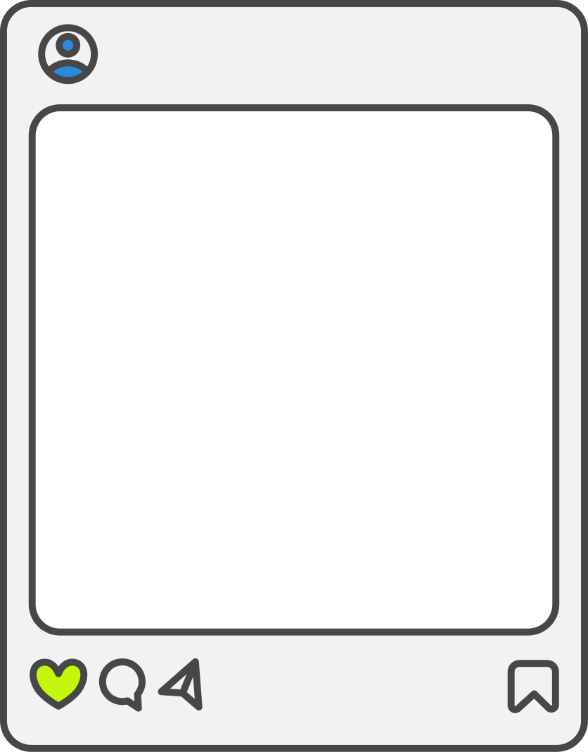


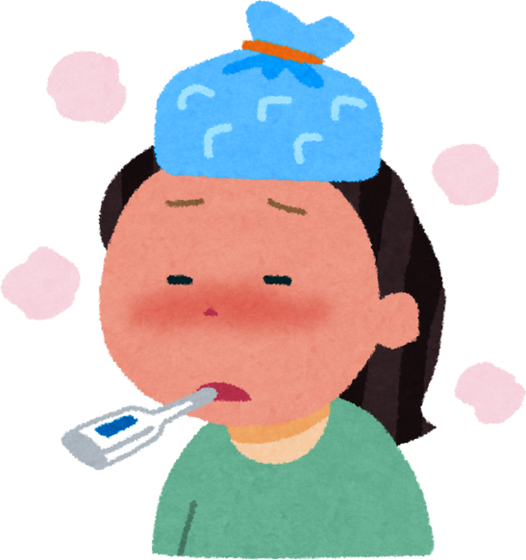
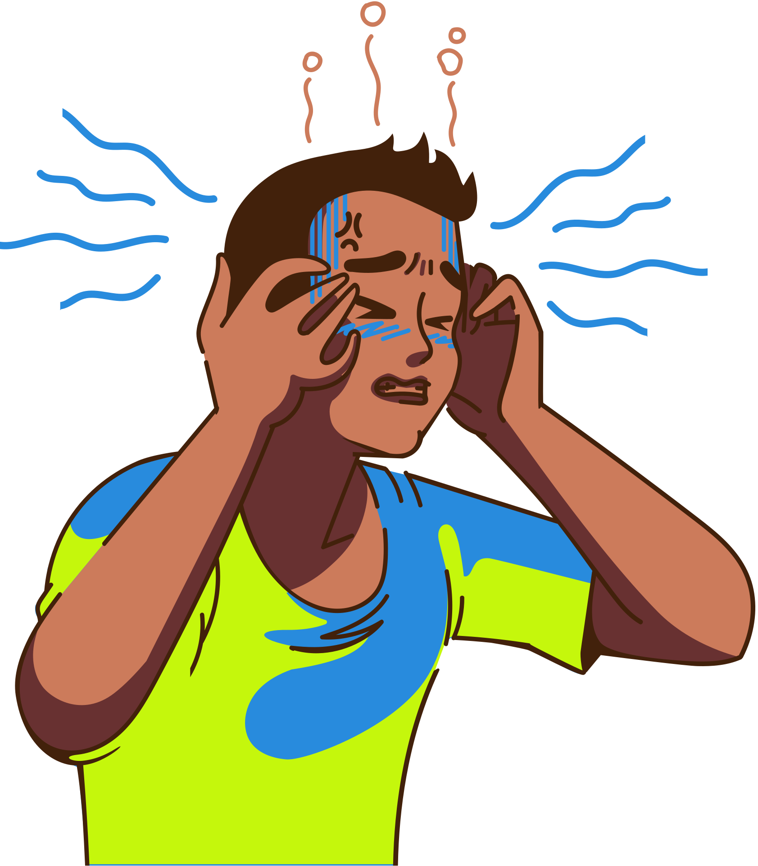
🖍️ Activity:
Match the Symptoms to the Correct Images
Materials:
Printed symptom cards, printed image cards, glue, markers.
Instructions:
  Distribute images of symptoms (fever, joint pain, rash, headache, nausea, etc.).
  Give students a set of symptom names.
  Have them match the correct names to the correct images.
  Discuss which symptoms are most serious and when to seek medical help.

Slide 7
REFLECTION
What would you do if someone in your family showed these symptoms?
Discuss in class

Slide 8

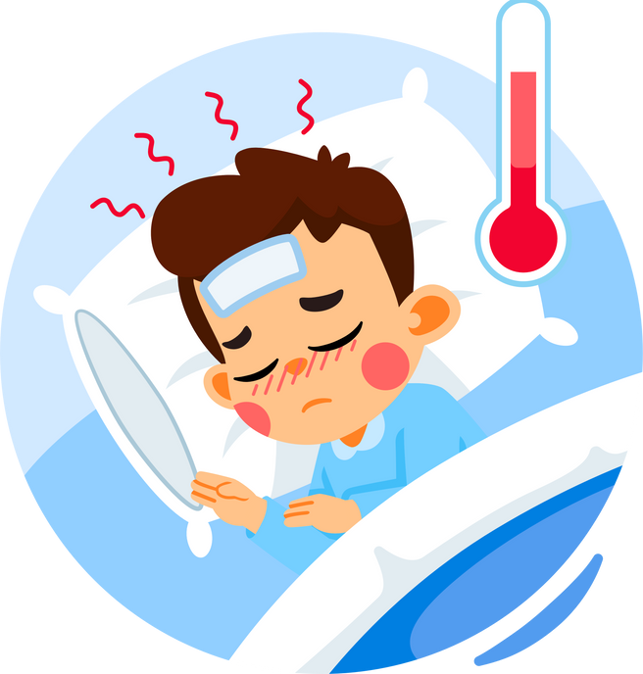
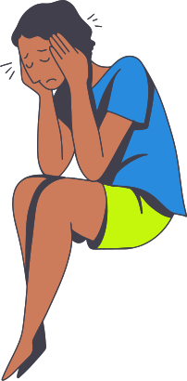
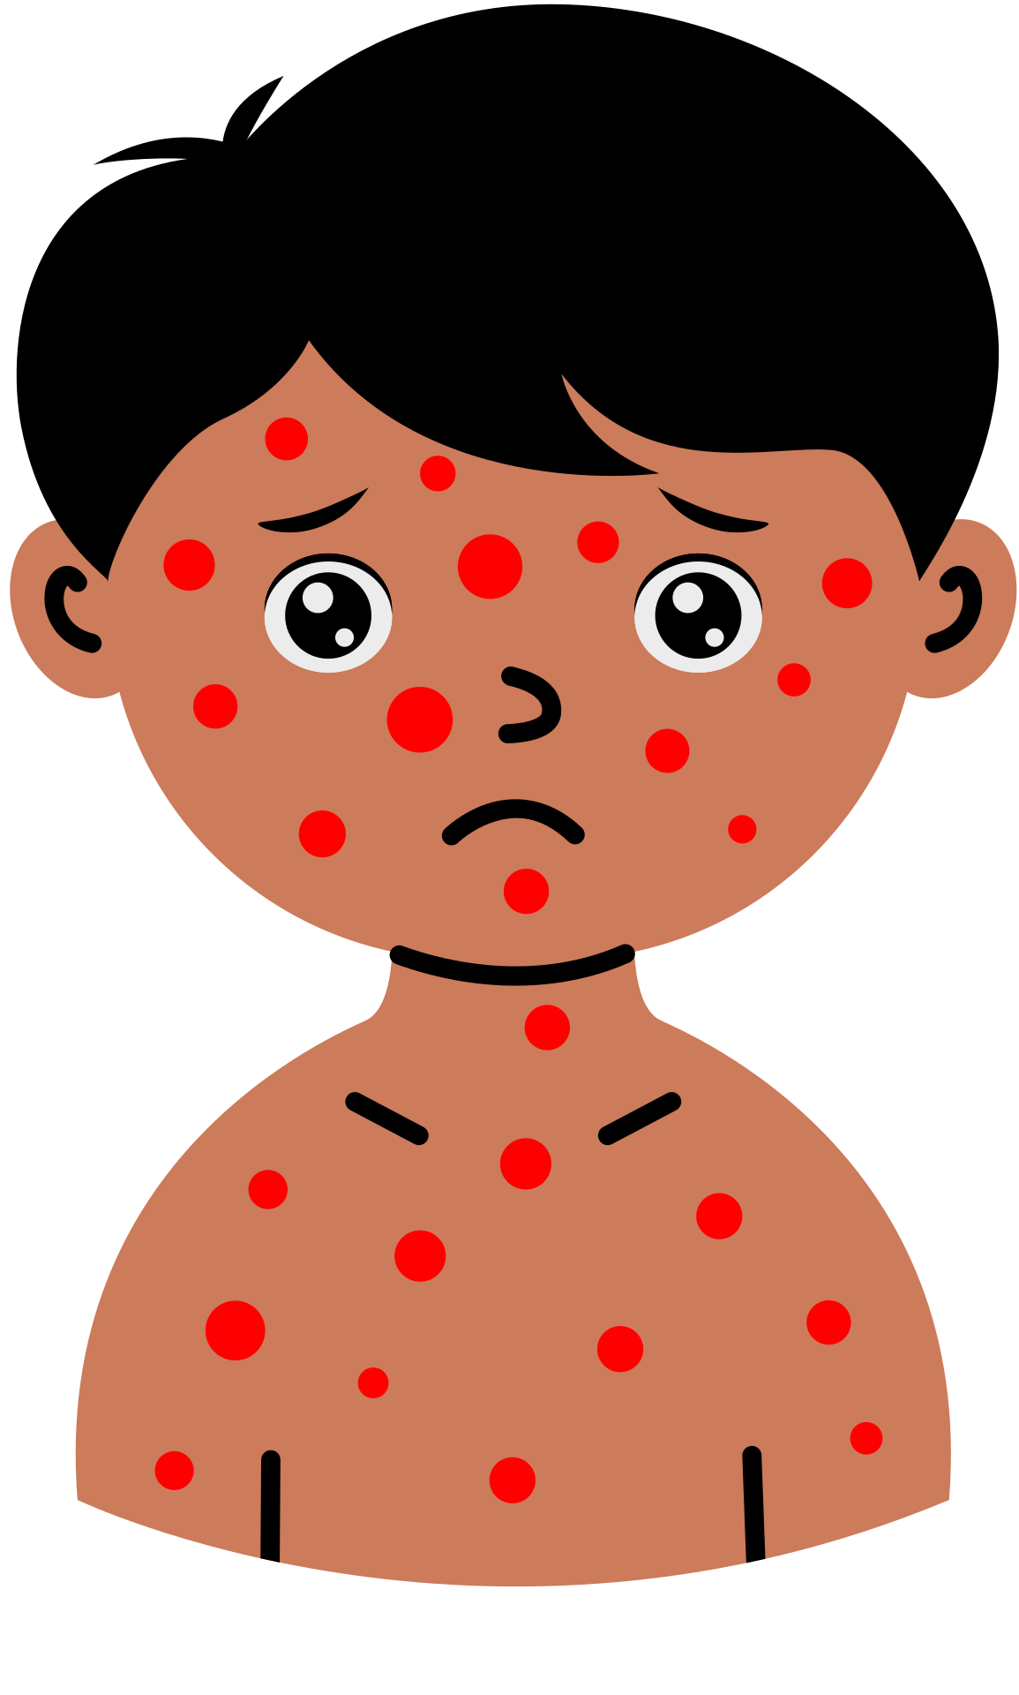
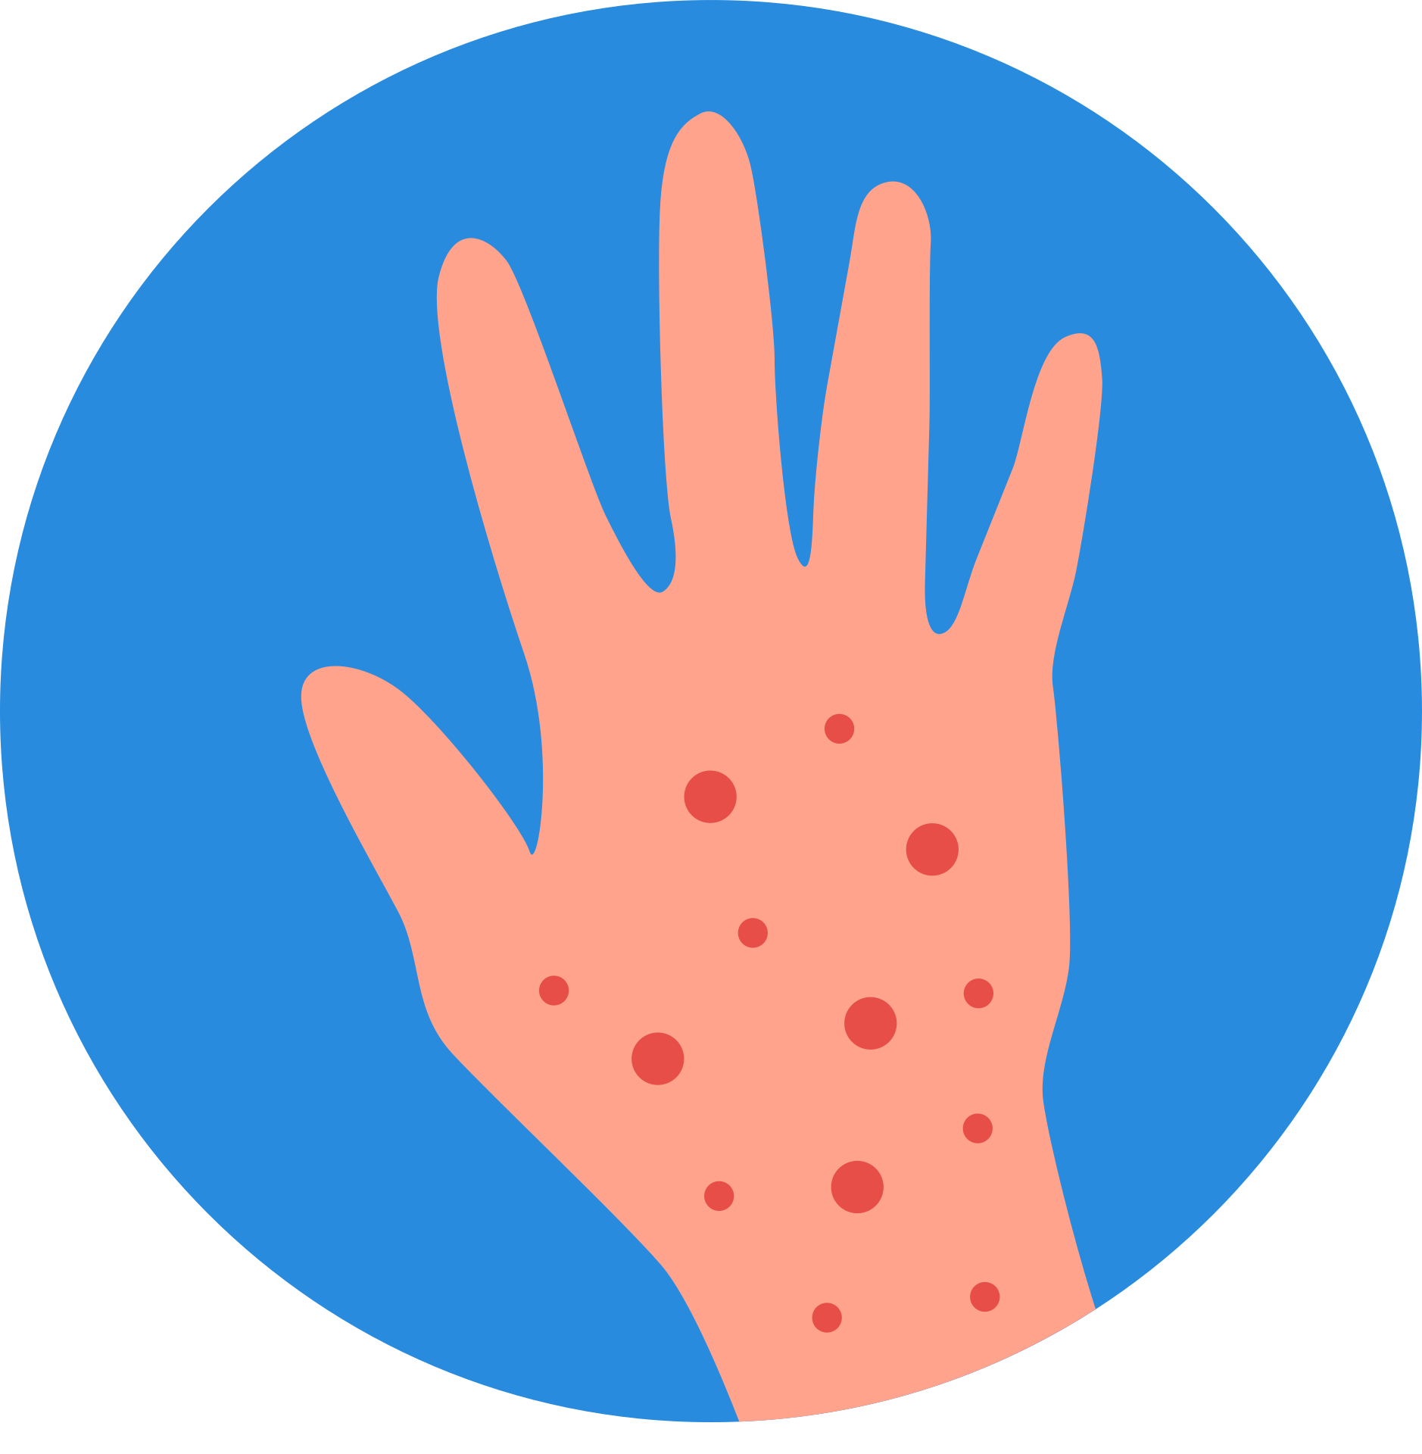

Slide 9
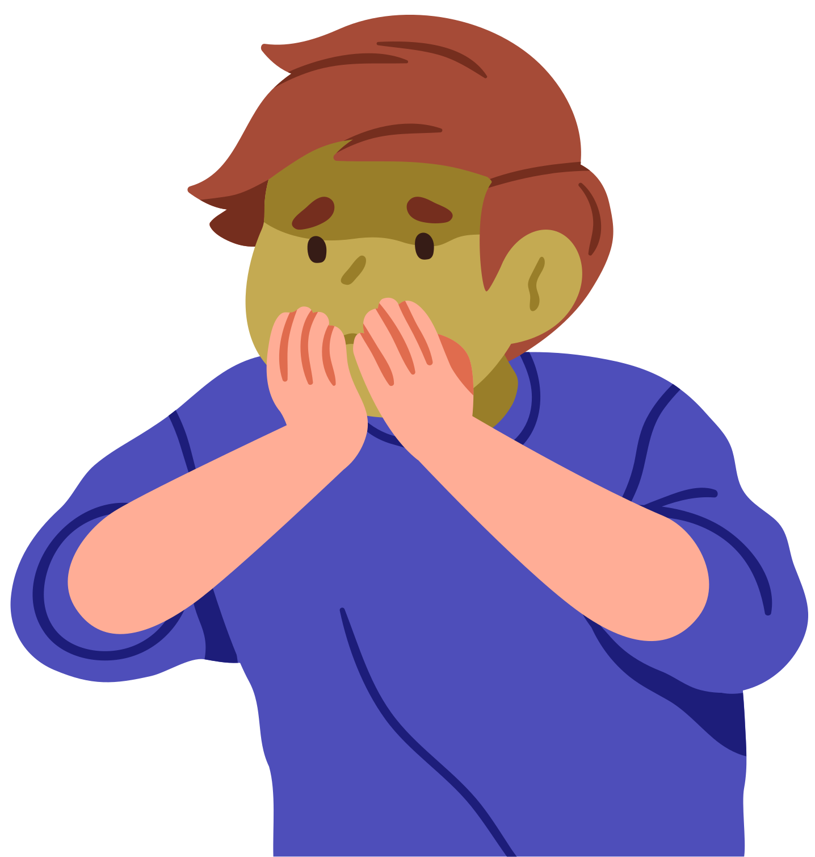
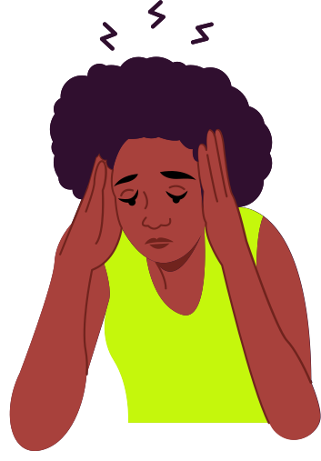
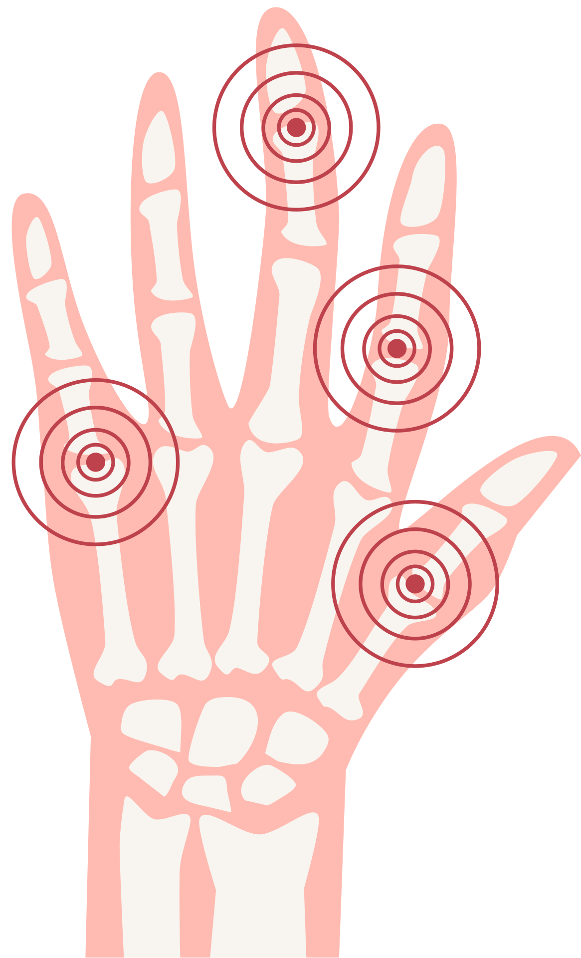

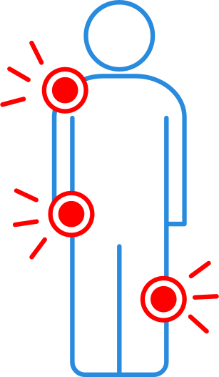
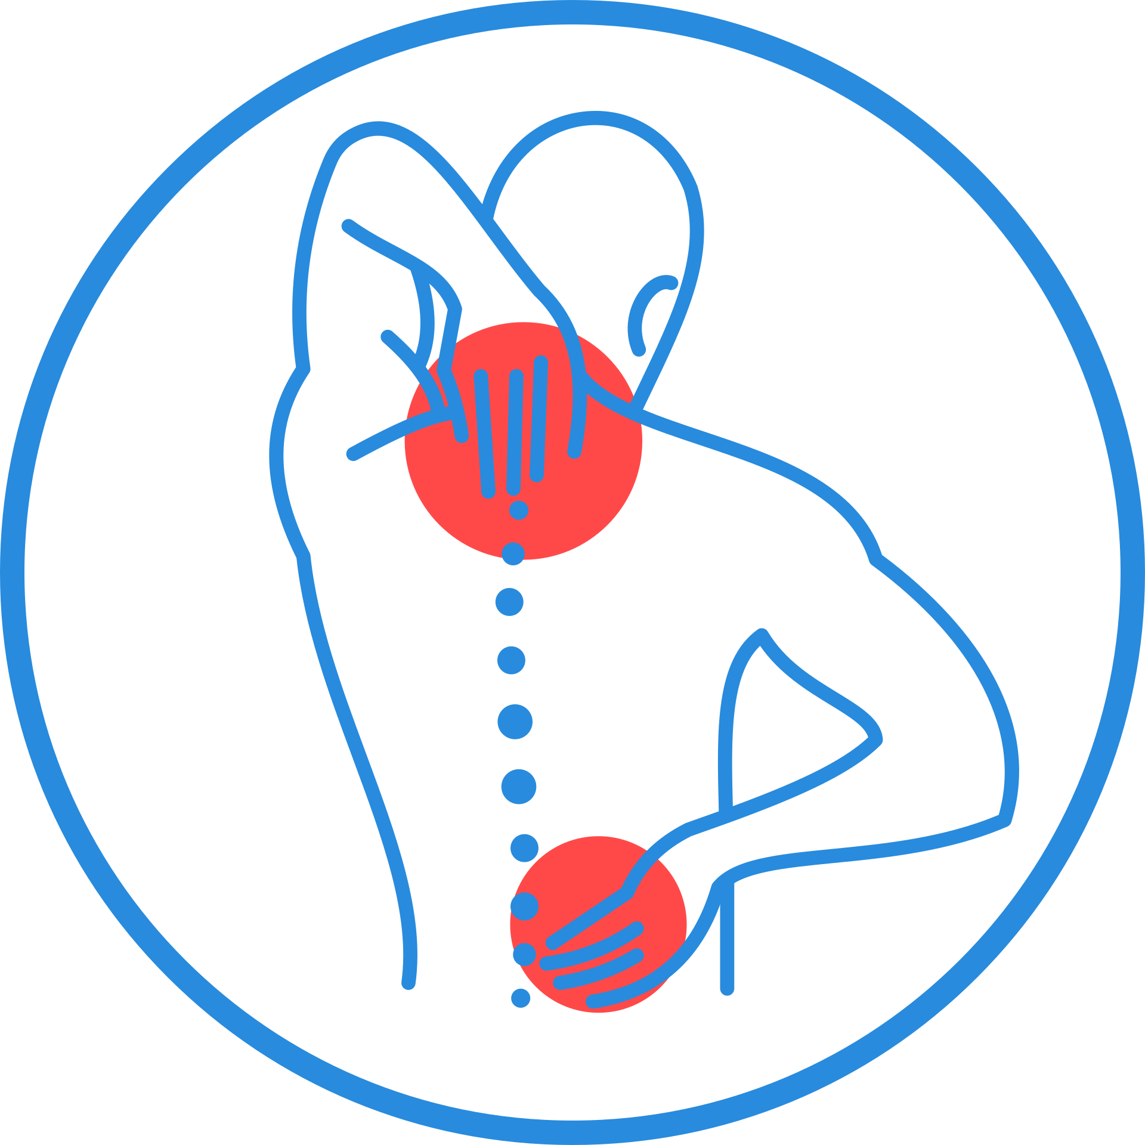

Slide 10


📖 Activity:
Write a Protective Message for Pregnant Women
Materials:
Paper, markers, pens.
Instructions:
  Imagine you are writing a letter to a pregnant woman in your community.
  Write three important tips she should follow to avoid mosquito bites.
  Decorate your message with drawings or symbols of protection.
  Share your message with the class and discuss its importance.

Slide 11

REFLECTION
How can we spread this important information?
Discuss in class

Slide 12
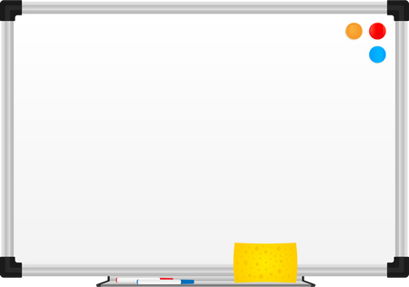


🕵️ Activity:
Detective Game – Spot the Differences
Materials:
Comparison charts, whiteboard, markers.
Instructions:
  Show a chart comparing the symptoms of dengue, Zika, and chikungunya.
  Ask students to circle what makes each disease different (e.g., joint pain is worse in chikungunya).
  Discuss why it’s important to recognize the differences.

Slide 13
REFLECTION
What symptoms do these diseases have in common?
Discuss in class

Slide 14


Activity:
3-Minute Challenge – Find & Remove Breeding Sites
Materials:
None (students observe their surroundings).
Instructions:
  At home or in school, students search for standing water in plant pots, tires, buckets, etc.
  List all potential breeding sites they find.
  Discuss how to eliminate these dangers (e.g., emptying water, covering containers).

Slide 15
REFLECTION
Why is mosquito control important for your community?
Discuss in class

Slide 16

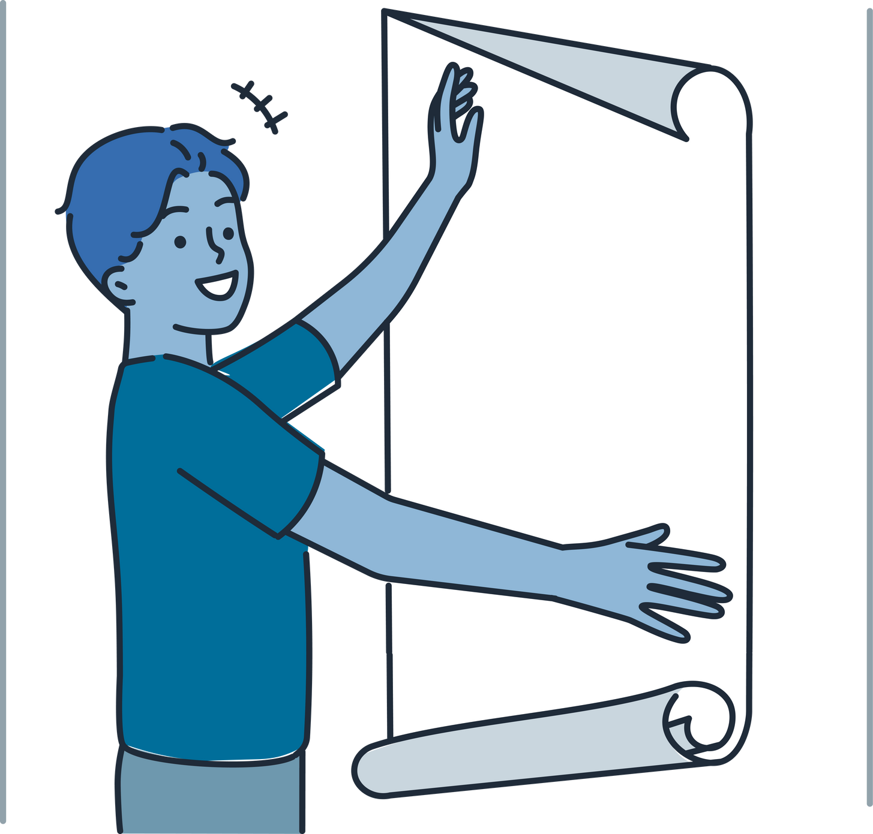


Activity:
Create a Poster on How to Eliminate Mosquito Breeding Sites
Materials:
Poster board, markers, paper, glue.
Instructions:
  Design a poster showing where mosquitoes lay eggs and how to stop them.
  Include at least three prevention tips.
  Present the posters to the class and hang them in your school.

Slide 17
REFLECTION
What can we do at school to reduce mosquitoes?
Discuss in class

Slide 18


Activity:
News Reporter Simulation
Materials:
None
Instructions:
  Each student picks a real statistic or fact about mosquito-borne diseases in Saint Lucia.
  They present it to the class as if they were news reporters.
  The class discusses the importance of raising awareness.

Slide 19

REFLECTION
How can we help lower these numbers?
Discuss in class

Slide 20


Activity:
"Mosquito-Fighting Superheroes"
Materials:
Paper, markers or colored pencils.
Instructions:
  Each student creates a superhero with a special power to fight mosquitoes.
  Draw the superhero and describe how they help prevent diseases.
  Present their superheroes to the class.

Slide 21
REFLECTION
What is the best way to protect ourselves every day?
Discuss in class

Slide 22


Activity:
Commitment to Action
Materials:
Their notebooks, pen.
Instructions:
  Each student writes one action they will take to help their community.
  They sign a pledge card and commit to their action.

Slide 23
REFLECTION
How can we share what we’ve learned with more people?
Discuss in class

Slide 24

Activity:
Interview in Action
Instructions:
Students should find a family member, neighbor, or acquaintance who has had dengue, Zika, or chikungunya.
They will prepare a series of questions to understand their experience, such as:
  What were the first symptoms you felt?
  How did the disease affect your daily life?
  What treatment did you receive?
  If you could go back in time, what would you have done differently to avoid getting sick?
  What advice would you give to others to protect themselves?
Students can record the interview on video, write a short summary, or act it out in class with a partner.

Slide 25

GROUP REFLECTION
What was the most impactful thing they learned from the interview?
After hearing these stories, which prevention measures do they think are the most important?

Slide 26




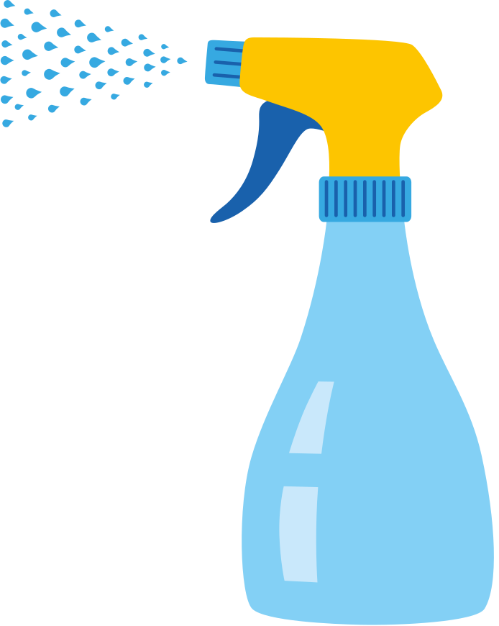




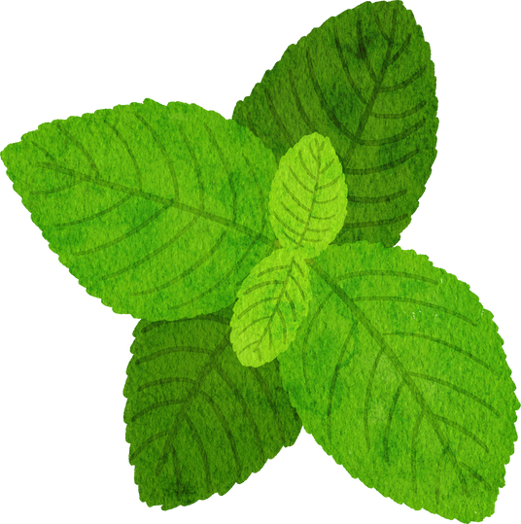
Activity:
Let’s Make Our Own Repellent!
Materials Needed:
  Water (½ cup)
  Coconut oil or olive oil (2 tablespoons)
  Lemon juice or apple cider vinegar (2 tablespoons)
  Essential oils (optional: citronella, eucalyptus, lavender, or peppermint)
  Empty spray bottle

Slide 27


🔬 Activity Steps:
  Mix all the ingredients in a container.
  Stir well and pour the mixture into the spray bottle.
  Test the repellent on a small area of skin to ensure there is no irritation.
  Apply it to arms and legs before going outdoors.
💡 Extras:
  Design a creative label for their repellent bottle.
  Explain to their families how the repellent works and why it is important to use it.

Slide 28

GROUP REFLECTION
Why is it important to use mosquito repellent daily in areas where mosquitoes are common?
How can they share this knowledge with their community?

